Slide 1
Employee and employment trends MPU 3362 & VC1
PUNCTUALITY

Slide 2
CLASS RULES
PLEASE BE PUNCTUAL
For online classes, you must ‘on’ the audio & camera whenever you speak
When you are not speaking, please mute your audio and off the camera.
Please use the chat option to communicate with lecturer and classmates whenever required
Participate actively during class.
Ensure you have scanned your attendance.
Always check your Microsoft Teams for any updates.

Slide 3
Lesson objective:
Discuss on the punctuality
Explain the important of punctuality

Slide 4
Punctuality
STEP 1
Think of a time when you were late for something really important. Describe how you felt. How did your body react?

Slide 5
STEP 2
Write five words that describe how you felt when you were late.

Slide 6
STEP 3
Circle the word that describes it best.
Then illustrate the circled word by drawing the facial expression.

Slide 7

Discussion
Now let’s think of some ways to improve being on time. Let’s brainstorm.

Slide 8
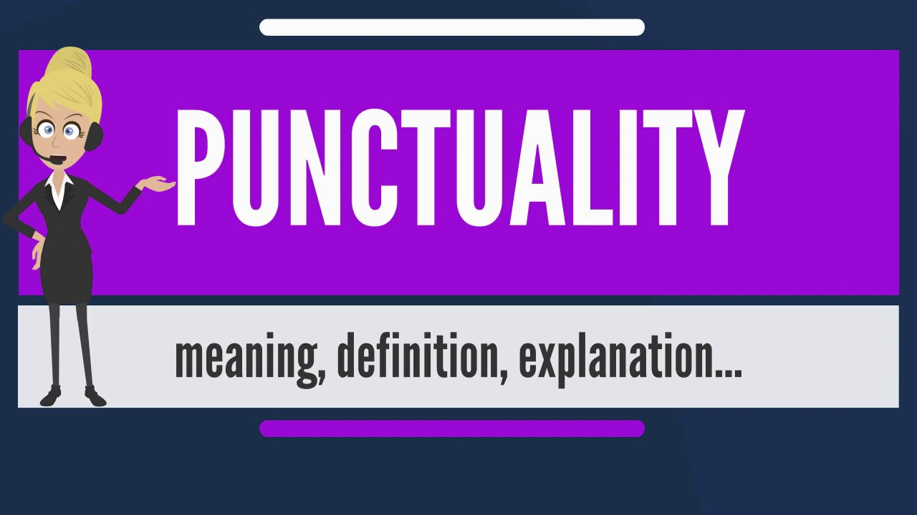
WHAT IS PUNCTUALITY?

Slide 9
DEFINITION
The quality of being on time and meeting deadlines.
A habit that can be developed.
More than just a time skill, punctuality is an important relationship quality and a show of personal character.

Slide 10
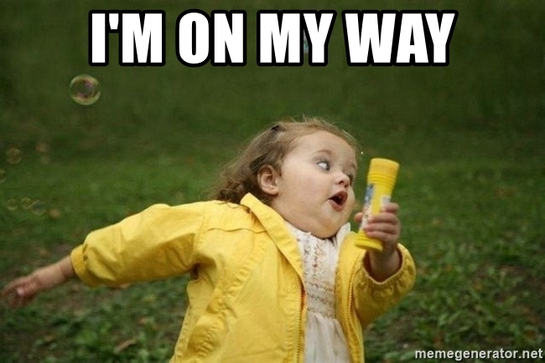
Have anyone told you this?

Slide 11
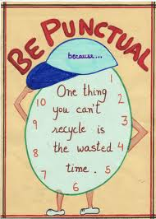
WHY PUNCTUALITY IS IMPORTANT?

Slide 12
Being punctual strengthens and reveals your integrity.
“Being punctual Is a promise”

Slide 13
Being punctual shows you are dependable.
“Being late Cannot be dependable”
“Being late Prepared with excuses”

Slide 14
Being punctual builds your self-confidence.
“Being Punctual High self-confidence”
“Being Punctual In control of your life”

Slide 15
Being punctual assures you’re at your best.
“Being punctual you have a few minutes to collect
your thoughts, review your materials,
and get your intention face on”

Slide 16
Being punctual builds and reveals your discipline.
“Being Punctual shows you set aside pleasure to
take care of your duty

Slide 17
Being punctual shows your respect for others.
“Being late selfish act, for it puts your needs above
another’s. You want an extra minute to do
what you’d like, but in gaining that minute
for yourself, you take a minute from
another, which is why….

Slide 18
Being late is a form of stealing.
“Being late you rob minutes from them that they’ll never
get back”

Slide 19
Being late disturbs the experiences of other people.
“Being late interrupting others”
“I made it my religion not to disturb the religion of others.”

Slide 20
Being late strains your relationships.
“Being late others feel under-valued”

Slide 21
Being late hurts your professional career.
“Being late hinder your professional success.

Slide 22
Being late takes a toll on your life.
It creates stress, results in embarrassment and forces you to come up with excuses for why you’re late, putting a strain on your honesty. Basically, it makes your life more complicated
“Hence, cultivating punctuality is an essential part in life.”

Slide 23
Next lesson
Managing meeting presentation

Slide 24


